Slide 1
Why Pass When You Can Run?
By Daniel Reiter

Slide 2
Winning In The NFL
Every team expects to win
A lot of money for Coaches and GMs
But how long do they last?
Different coaching styles
Which is right?

Slide 3
NFL Sabermetrics?
Finding trends for the past 3 seasons
Game-by-game statistics from Stattleship API split by Road and Home Teams
Looking at Offense, Defense and Special Teams (but nothing too obvious)
Not every result will equal what is expected

Slide 4
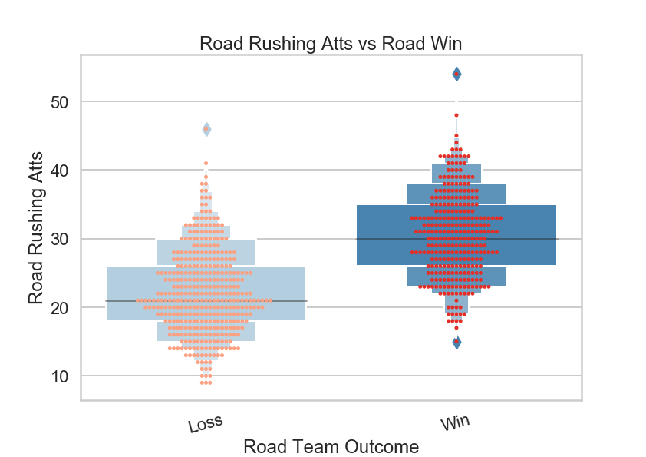
Running the Football
Rushing Attempts are Important
Not even mentioning Rushing Yards

Slide 5
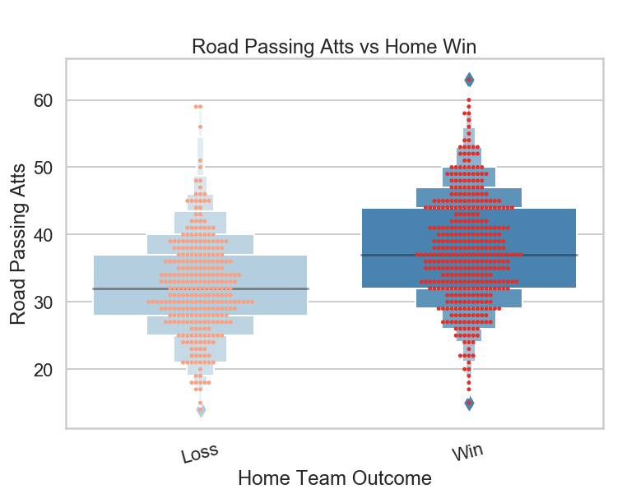
Passing the Football
Road Passing Attempts helping Home Team
Passing Yards not statistically significant either (high p-values)

Slide 6
It doesn’t end there…
Correlation between Road Points and Home Points was not statistically significant (as well as Total Yards for each)
Meaning one is not predictive of the other
What does this mean for shootouts?

Slide 7
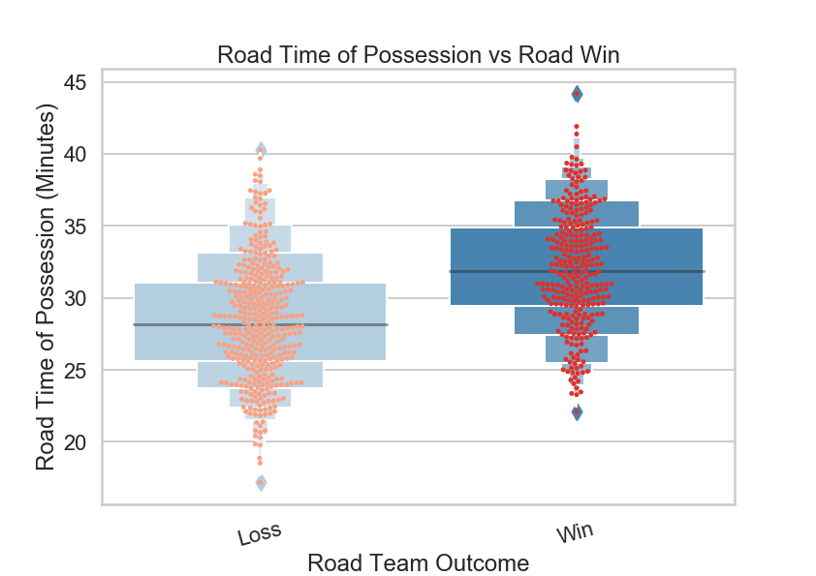
Long Drives vs. Big Plays
Controlling the ball is important as well
May be better than quick scoring plays through the air

Slide 8
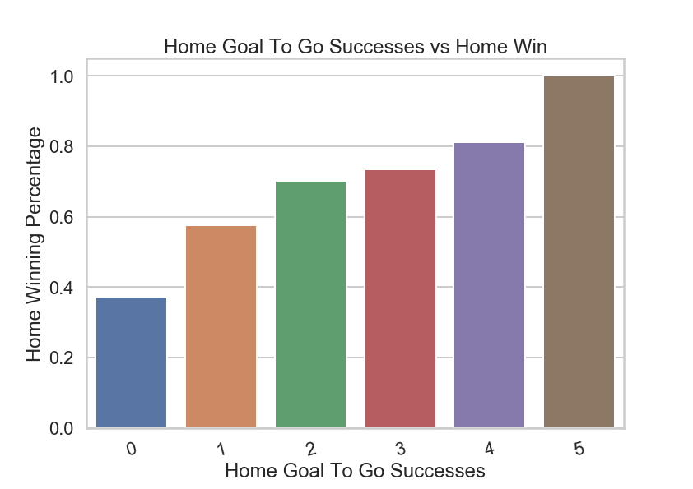
Score When You’re Close
Consistent upward trend when successful
Emphasizes importance of Touchdowns

Slide 9
Offensive Summary
Running the ball more important for winning than passing
Both Rushing and Total Yards were statistically significant while Passing Yards were not
How about Defense?

Slide 10
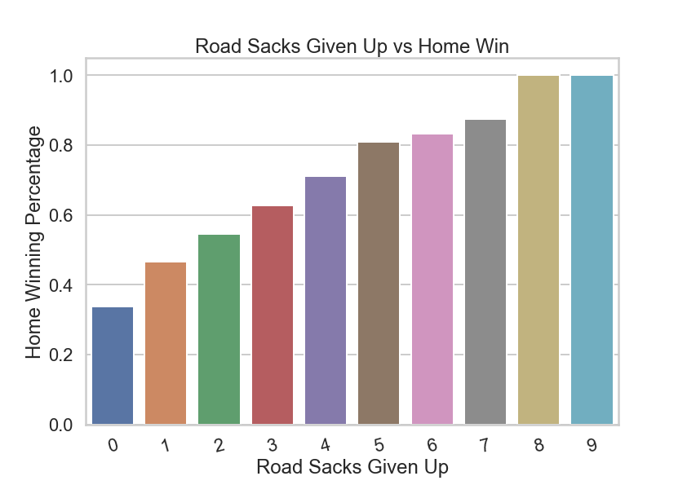
Hit That Quarterback!
Improved winning percentage after each sack
Pressure is key

Slide 11
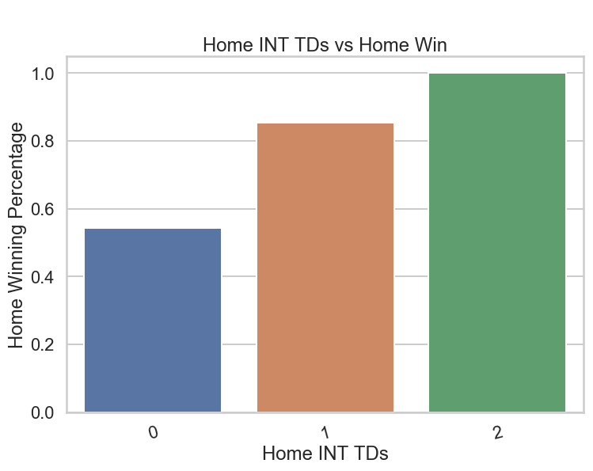
Defensive Scoring
Massive increase in win percentage
May seem obvious but the growth is staggering

Slide 12
How Critical Are Turnovers?
Overall both showed statistical significance for win percentage except in lower percentiles for fumbles
The relationship between Interceptions Given Up for each team was statistically significant while Fumbles Lost was not
Some support for sloppy games

Slide 13
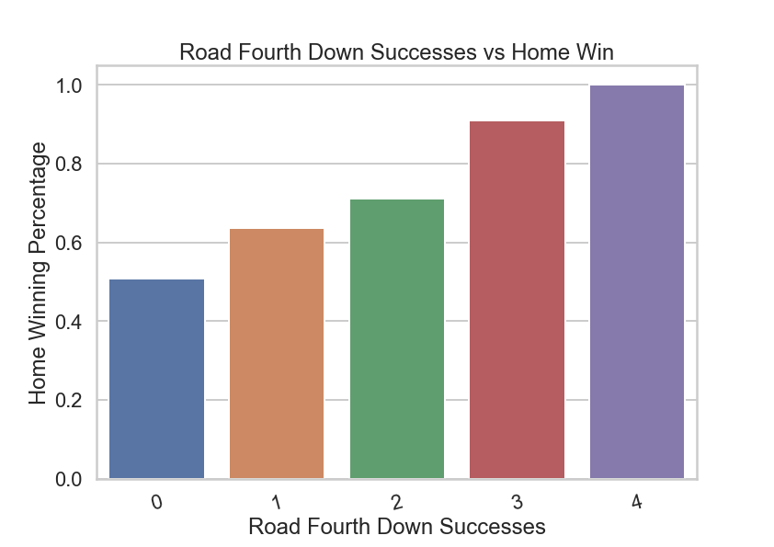
How Big Is Fourth Down?
Better off allowing Fourth Down success
Might be a sign of having a huge lead

Slide 14
Defensive Summary
While yards are significant, sacks and turnovers as well as defensive scores have big impacts on winning
Allowing teams to succeed on Fourth Down is not a bad thing

Slide 15
Extra Thoughts
Special Teams showed the expected impact
All of these Bar Charts are based around the average
While split among Road and Home teams, both showed similar trends in similar plots

Slide 16
Machine Learning Process
Made Road and Home Win models
Used Logistic Regression and Random Forest
Both very accurate but high log losses

Slide 17
Logistic Regression
Road Win: Around 96% accuracy
Home Win: Around 91% accuracy
Some of the most impactful features include Total TDs, Made Field Goals and turnovers (for either team)
All types of yards were low

Slide 18
Random Forest
Road Win: Around 92% accuracy
Home Win: Around 86% accuracy
Some of the most impactful features include Kickoffs, Total TDs, Rushing Attempts and Time of Possession (for either team)
Plays from Special Teams were low

Slide 19
Comparing Models
All highly accurate with Road Win being better than Home Win
Logistic Regression was more accurate for each team
One focused on scoring and turnovers, other on scoring plus controlling the football

Slide 20
Issues/Next Steps
Problems with API
More of a game-by-game overview instead of focusing on individual teams
Look at more than just past 3 seasons
Dig deeper into situational decisions

Slide 21
Conclusion
Passing Yards consistently showed low impact
Image of a shootout may not be correct
Sacks, turnovers and scores important for defense
But none guarantee victory, mixed models
For more info: https://github.com/SportsReiter12/Data-Science/tree/master/NFL%20Capstone%20Project

